Slide 1


Airport Luggage Simulation

Slide 2
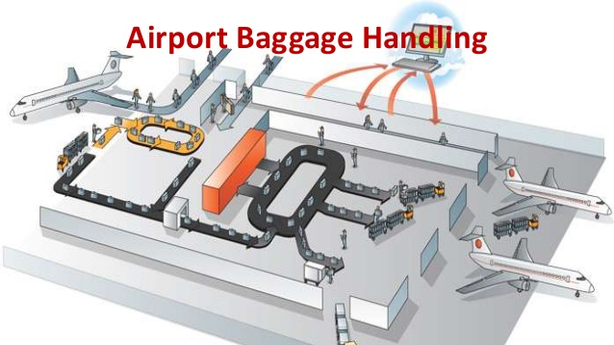
Our Client and Our Task

Slide 3
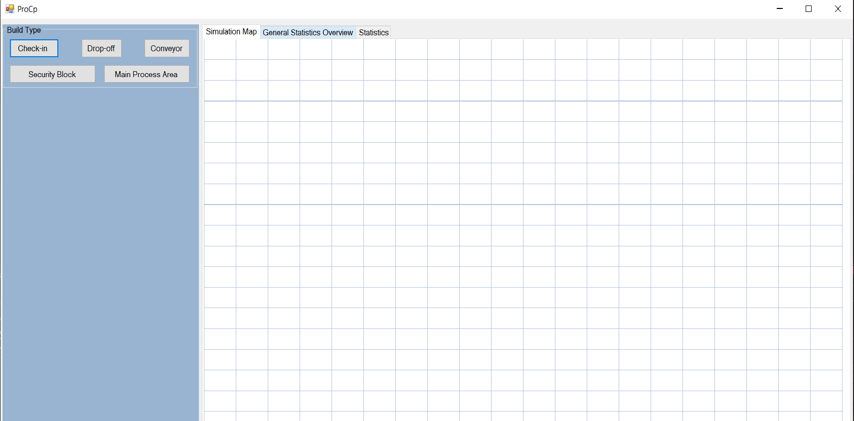
What we have so far

Slide 4
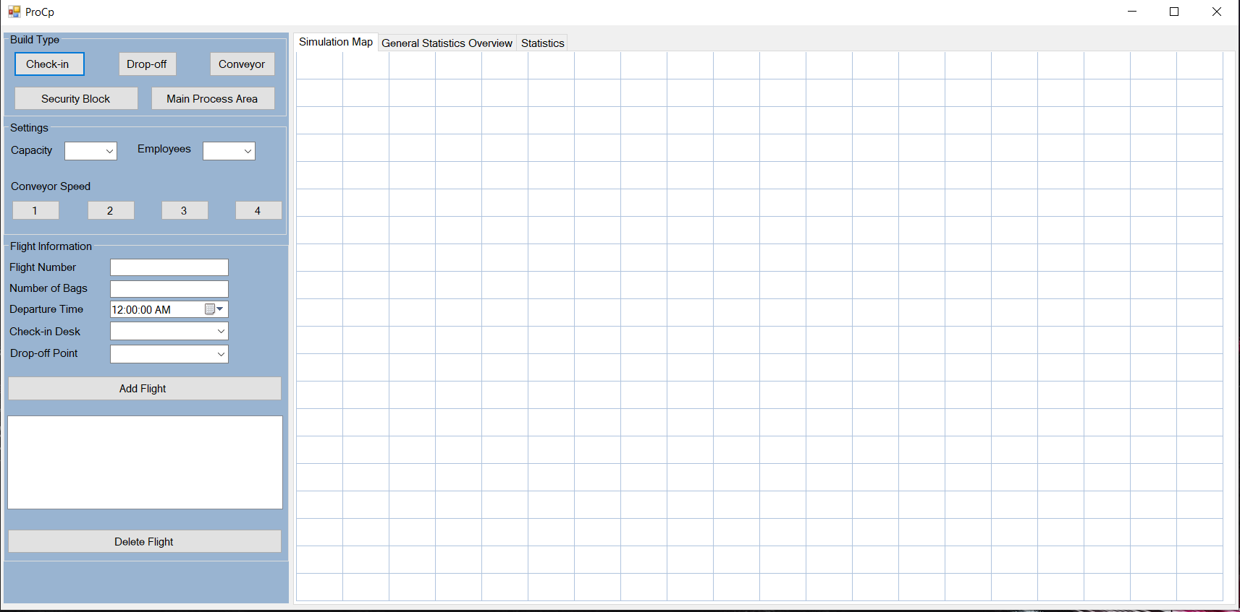

Slide 5
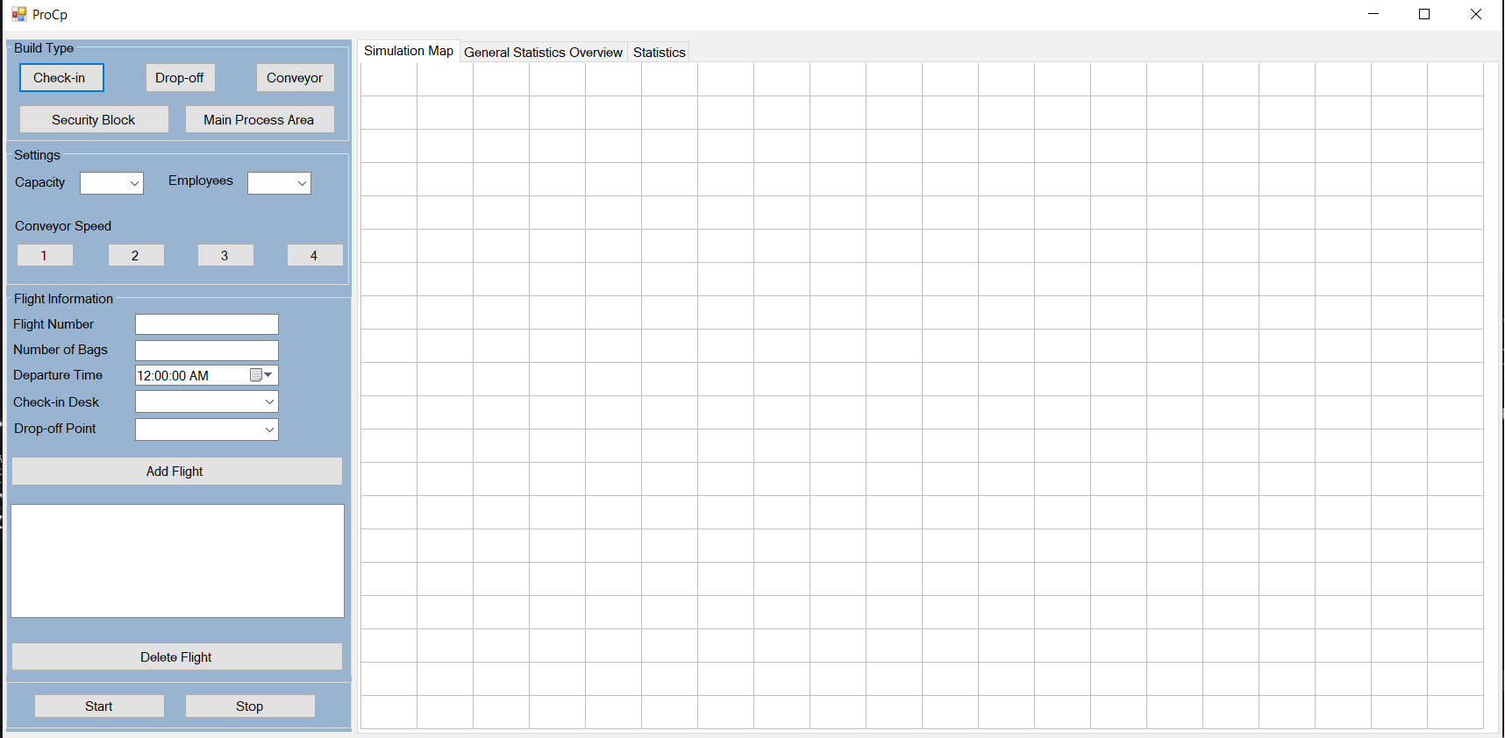

Slide 6
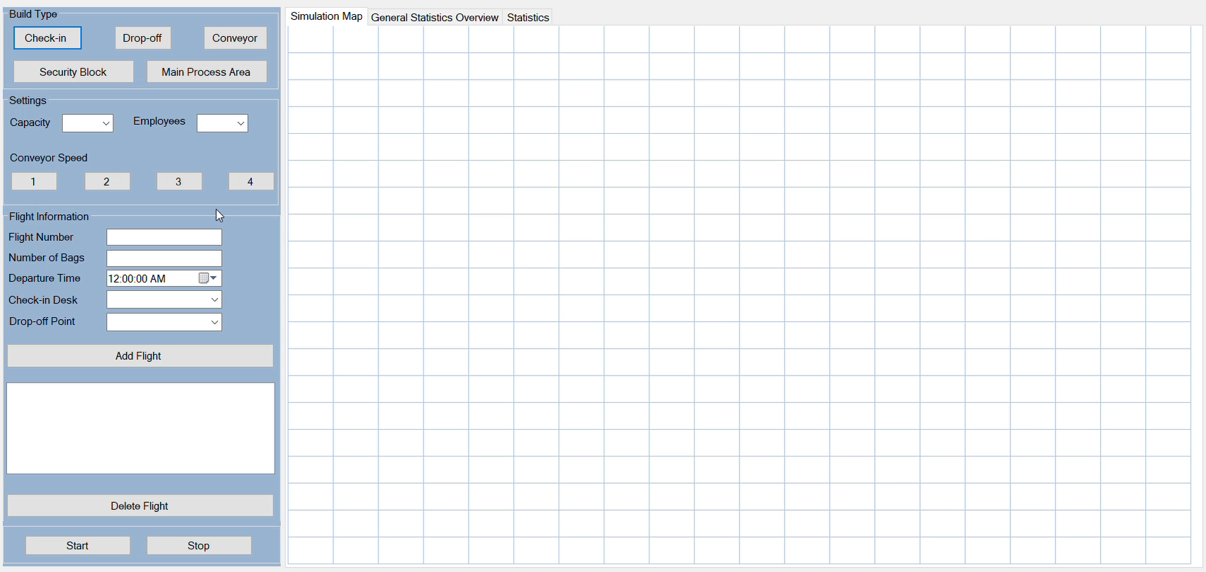
Short Demo

Slide 7

How are we going to proceed?
Add functionaltites of the code behind
Visualising the transporting system
Unit tests

Slide 8

Questions

